Slide 1







Interfaces, Models, and Monitoring for Resource-aware Transformations that Augment the Lifecycle of Systems (IMMoRTALS)
Matt Gillen, Partha Pal (BBN)

Slide 2
Organizing adaptations into phases
Phase1
Driven by changes in functional and extra functional requirements and constraints
Evaluation is focused on correctness (i.e., it is mostly verification)—no qualitative distinction is made among the possible solutions
Verification is through tests to show that functional intent is preserved
Realized by substitution of components that follow the same usage pattern as baseline
Substitute(s) that could work exists; choose & message the code
Compose a substitute from available components, and then message the code
Phase 2
Driven by changes in 3rd party software (OS, Libraries) or services
Evaluation will consider qualitative differences among possible solutions and the one that the DAS produces
Verification: same as before
Realized by combination of basic mutations on code: substitute, add (i.e., compose), and remove
Still mostly changes in source code to produce new binaries
Will consider composing simple “controller” code enabling simple runtime behavior adaptation
Will extend the supported patterns of usage
Phase3
Focused on handling changes encountered at runtime by runtime adaptation
Evaluation will focus on runtime aspects such as time taken to adapt, amount of disruption, level of degradation etc.
Verification: same as before
Realized by pre-installed instrumentation in the application that responds to observed runtime changes
Will change the behavior of the application by altering the data and control flow
Will modify the application binary (rewriting or downloading bytecodes)
May adapt (update or modify) the initial instrumentation as well

Slide 3




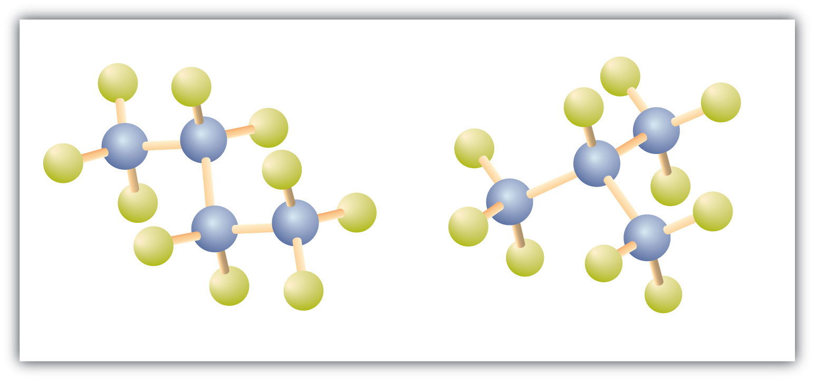
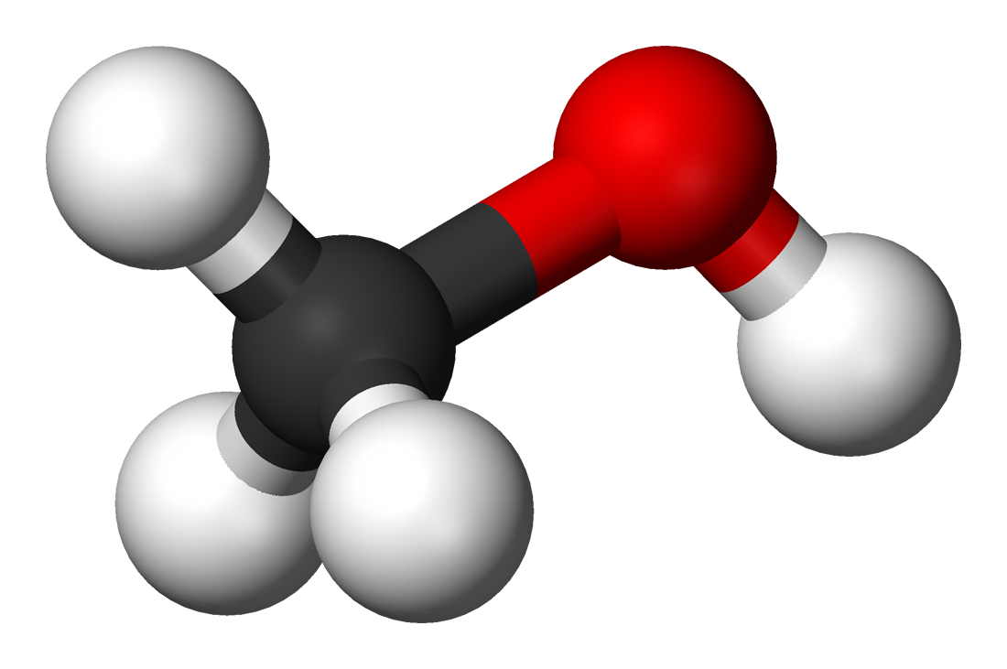




Deriving Adaptation: 1
Deriving adaptation involves reasoning about the software and the adaptation trigger
Adaptation trigger could be a “change request” or an “observed or detected change”
Usually, observed/detected changes → runtime
Changes observed at runtime may result in offline (outside of the executing mission) adaptation (e.g., modifying source code to create new binary)
Of course, requests to support new deployment environment or modified functionality are offline change drivers
Reasoning takes place in “model space” – i.e., in terms of abstract representation of code, resources, their relationships
DAS workflow uses
SPARQL queries over Triple store: identify candidates for adaptation
Resource DSL (refinement and variational types): quickly evaluate combinatorial space of adapted systems
Essentially, algorithmic use of the combined power of SPARQL and Type system
Change request
Reasoning and Analysis
Detected changes
DAS machinery
models
Source code
Code massaging
Adapted code

Slide 4
Deriving Adaptation 2
What is in the model space:
Domain knowledge
Currently, simple/high level/global/axiomatic rules e.g.,
if resource R is contested, reduce consumption of R
May need domain-specific (i.e., tactical SA) specific refinements or concretizations e.g.,
Bandwidth consumption depends on size of SA messages being sent
Sufficient knowledge about functional and extra-functional specification of
The (baseline) application:
Functionality: Definition, Use, Usage Pattern
Extra functional: Resource dependency, Resource usage
Ingredients/raw material for adaptation- code that transforms domain specific data types, domain specific functions: similar functional and extra functional description
Simplifying assumption: not every line of the baseline is adaptable – we are demonstrating the technology with a specified subset (control points)
End to end flow
See next page
Reasoning
Guided search with constraint satisfaction, type checking, and type selection
Declaration of X*
Definition of artifact X
DFU
Control Point1
Other uses of X
Definition of artifact X
Control Point2
Other uses of X and Y
DFU
Declaration of Y*
Currently Java objects, so definitions are classes
DFU s could generalize to artifacts other than classes
Application Code
For control points, the intended use of the objects, and the functional and extra functional specification of the code implementing them are available
Note:
functional→ given,
extra-functional→ discovered

Slide 5
DSL
Adaptation Trigger
Resource(s) in question & deficiency
Functionality in question & deficiency
Usage of these resources in code
SPL/PLA, Models
SPL/PLA , Models
Program Analysis
Intersects with the “control points”
Available components and their resource/capabilities
SPL/PLA , Models
Domain knowledge
yes
Replacement available?
no
Resource type check
Was able to compose
Compose a substitute
This step may comeback empty (e.g., raw materials are not sufficient)
DSL
Adapt by substitute
Unified High level Workflow of Phase 1 DAS
DAS workflow includes back arrows from these stages that are removed for brevity
Build
See next page for blow out of Synthesize
Test

Slide 6
High level breakdown of Composing a Substitute
DFU use in Baseline
{Functionality, Resources, Properties}
Deficiency
Domain knowledge
DAS Processing
Need {add | remove}
{functionality, resource, property}
Code {functionality| modifier}
{resource, property}
Code {functionality| modifier}
{resource, property}
Code {functionality| modifier}
{resource, property}
SPARQL Guided search
DSL
DSL Type selection
DSL Type check
DSL
Code Generation & Massaging
Synthesized Substitute

Slide 7
Evaluating Adaptation
We use evaluation to assess the qualities of the adaptation, and leave assessment of functional correctness to verification
We would like to consider (show continued progress over time for) the following aspects
Fidelity: Has the application’s performance degraded.
Caveat: in some (most?) cases in our domain and scenario, degradation is expected
Situations like a more efficient sort or search is found or synthesized to meet the CPU or memory constraints are rare in our platform
Performance: how efficient was our reasoning/search, how efficient was our transformation
Scale: how many simultaneous changes, instrumentation points do we support
Level of autonomy: how much human involvement was needed
Robustness: did the transform code break under conditions where it should not have
How do we evaluate these qualities
Experimental: running lots of tests, collecting and analyzing data
May be some of these could be done analytically– i.e., type systems (TBD)

Slide 8
Verifying Adaptation
What are we verifying
Correctness
Resource type match (in DSL)
Programming language checks (i.e., it builds)
Passes regression tests
Intent (functional intent) is preserved modulo change requests, tolerance (i.e., the mission accepts 3 updates per second instead of 5, or accepts lower resolution)
How:
The 1st three can be done automatically within the DAS
Verifying intent preservation automatically is hard, some amount of human intervention is necessary

Slide 9
Realizing Adaptation
Implement the prescription
Templating: you have a template– fill in
Works great with substitution
A DFU may have its template (e.g., init-work-close pattern) that is modelled, the baseline application may also have a template of how the DFU is used (e.g., where else it is used, what are its dependencies) that is also modelled
Specializing– start with a copy the DFU being modified and splice in transforming code
Rely heavily on the model of the DFU and the transforming code
Model based generation (TBD/Thinking about it)
Current: configure a product from the model (and the actual code artifact corresponding to the components)
Push it down to generating newish code– e.g., models are for declarations, loops, specific actions– from which a class can be constructed
Code massaging: handling of the name, ordering, usage pattern differences and programming language issues when DFUs are substituted

Slide 10
IMMoRTALS Phase 2 CP Candidate Ideas
Respond to changes in a 3rd party library that the application needs:
Change: offline i.e., notification that the change happened and functional spec of the change is provided before deployment
Nature of change: method moved, method removed, method changed– parameter dropped, method changed– parameter added
Adaptation: offline
Result: new application binary generated
Respond to changes in OS feature
Change: offline
Nature of change: System services change in API or functionality
Adaptation: offline
Result: new application binary generated
Respond to changes in an external service/software that the application depends on
Change: offline, online (i.e., we can discover the changes in service at runtime?)
Nature of change: data item moved to a different location, new data item added that needs to be displayed
Adaptation: offline (i.e., runtime detection will trigger DAS)
Result: new application binary generated

